Slide 1
Lecture Eight
Applied Space Cyber

Slide 2
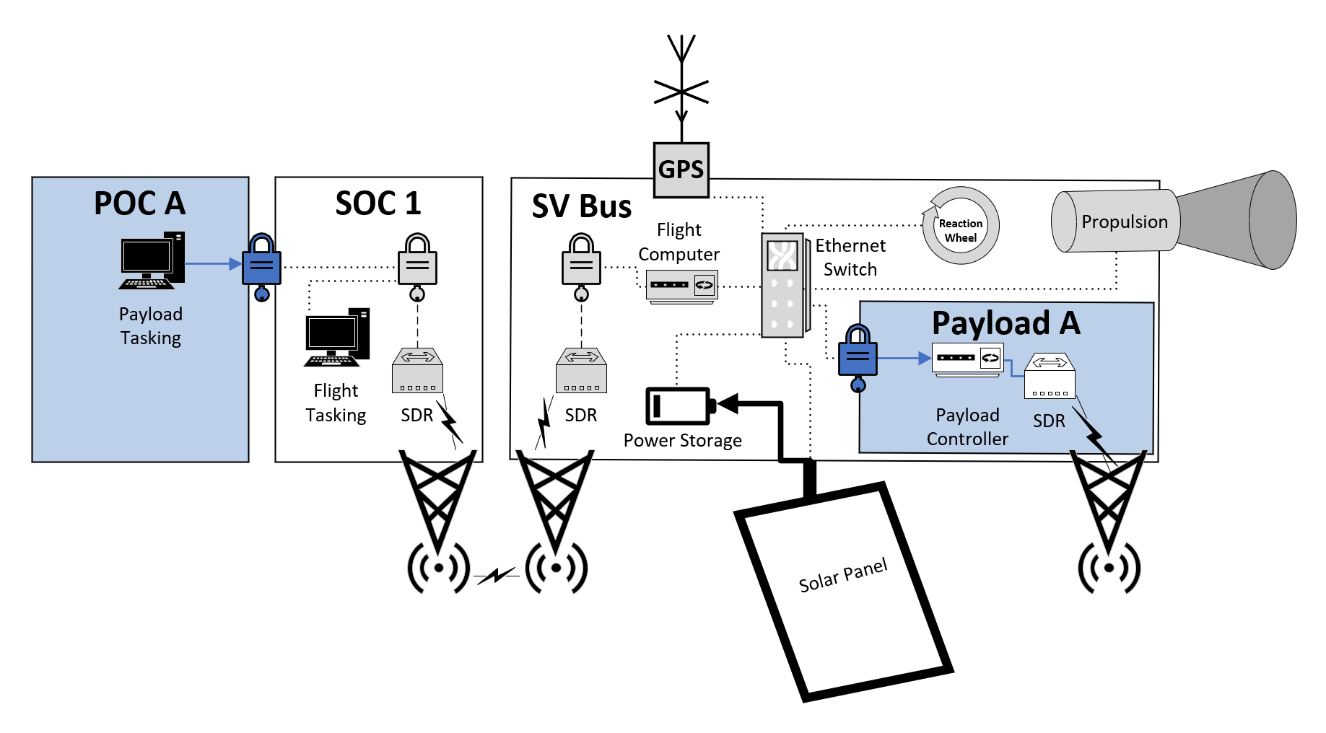
EARTH
SPACE
Notes:
Bus Vs. Payload

Slide 3
About our system
Space ops company owned / flown Bus
Investment firm owned payload; they trade in agriculture stock futures
SAR Payload for monitoring fields
Most of the year passive monitoring of images for anomalies
During fall when crops are brought in, much more active tasking during 3-week window peak harvest.
15 minute passes every 2.5 hours
3-4 passes each day over the US
1-2 pass a day over GEP
1 pass a week over Hawaii (coffee futures are very valuable!)

Slide 4
Technical Details About our system
50mbps (x60seconds x15 minutes) = 45GB per pass
3D SAR image is 5GB of bandwidth to transfer to ground ~8 images downloaded per pass if we leave 5GB for tasking, telemetry, etc
Images can be generated in as little as 15s or as long as 12m so, the bottle neck is bandwidth not an ability to take images

Slide 5
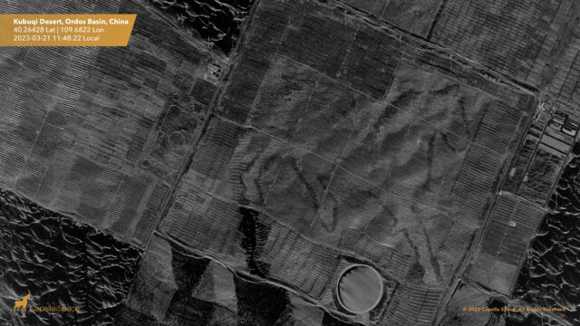
Synthetic Aperture Radar SAR
Credit to Capella Space
SAR works by bouncing microwave signals off the Earth's surface, and can be used to create 2D images or 3D reconstructions

Slide 6
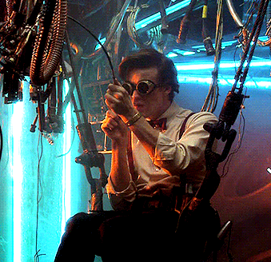
Simple Patching Example 1
2GB upload and re-install of SDR firmware; VXWorks, 10 RCE vulns
Have to power cycle SDR; maybe lose comms

Slide 7
Simple Patching Example 1
Lets say it’s the space ops company SDR to fly the satellite:
They already got paid 25M to build and launch CROPSAT-1
They charge 2.5M a year to fly/operate it
4 years left in operational window (10M max revenue)
CROPSAT getting hacked jeopardizes my trust of 100 other sats I operate

Slide 8
Simple Patching Example 2
Lets say it’s the payload owner SDR used for SAR:
They make 50M each harvest season
They already made enough in year 1 to cover cost of building and operating satellite
4 years left in operational window, potential 200M Revenue

Slide 9
Simple Patching Example 3
Lets say it’s the bus SDR:
10MB patch to fix critical vulnerability that allows unencrypted communications to the bus
The patch lowers the bandwidth of the satellite to 10mbps

Slide 10
Simple Patching Example 4
Lets say it’s the payload SDR:
10MB patch to fix critical vulnerability that allows simple low power EW attack to fry SAR sensor
The patch increases the size of each SAR image to 10GB, halving operations.

Slide 11
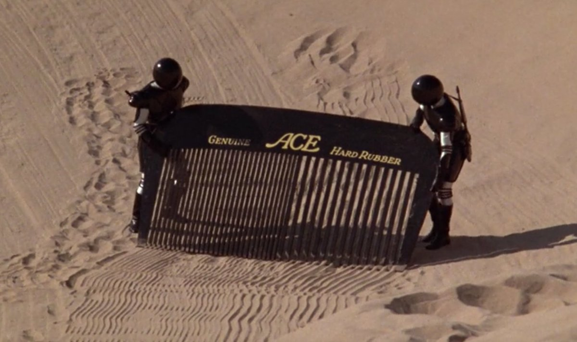
Threat Hunting
Tradecraft considerations
What is impact of active forensics on SV?
Compute (CPU/RAM)
Storage
Bandwidth
Power
Bus operator/owner: want to threat hunt, don’t care about BW impact because you’re trying to protect your constellation
Payload operator/owner: Don’t want bandwidth to cut 1 of 8 images for each or a pass

Slide 12
Threat Hunting Example 1
Bus operator threat hunters
Discrepancies between observed SV behavior and telemetry being received on the ground
Payload operator has complained that bus maneuvers are happening slightly off schedule and slightly off target for aiming SAR sensor
Excessive forensics on the ground have uncovered no issue, SV is suspected of potentially having malware or issue.
How would we go about prosecuting it?
How would we add functionality to flight SW
How would we reach execution out of the flight SW, within actual OS

Slide 13
Threat Hunting Example 2
We suspect something on the payload is messing with SAR images before they are sent down
There is some minimal edge processing of the images happening in the payload
Extensive forensics in POC have shown nothing terrestrial
How would we go about prosecuting the payload control computer?
Maybe we want to look out of band and pull down an image or two to see if it is being messed with in transit, but these are 5GB

Slide 14
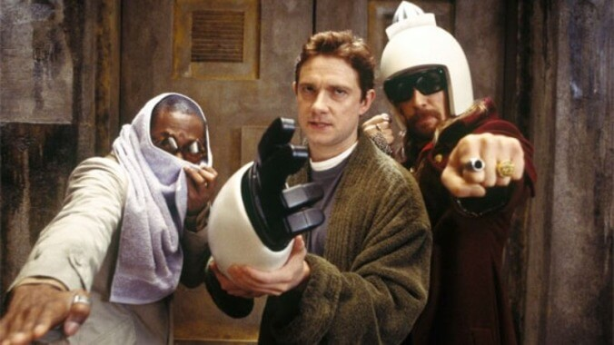
Pen Test
Evaluate components
Evaluate integrated systems

Slide 15
Pen Test Example 1
Bus operator has to test at least one of its orbiting SVs for a compliance issue
It has picked one of its backup SV’s orbiting in the constellation of 100
How do we enumerate ports and vulns on the bus across multiple components?
Should we limit ourselves to LoL?
Cite the SDR off switch being removed; what if you were enumerating hex values via an API to see which made the SDR do what? That is a common sort of practice on the ground right?

Slide 16
Pen Test Example 2
We have concerns about not-so-complete logical separation of some physically connected parts via the hardware encryption device
How would we go about evaluating this?
Is this required to be done on a flying asset?
Is HWIL satisfactory?
What if the production units were interdicted and the EDU was not?

Slide 17

Red Team / Adversary Emulation
Have to make sure you don’t give false sense of security by being too loud, or not operating under the constraints
Asynch ops is a huge challenge

Slide 18
Red Team / Adversary Emulation Example
Bus operator has asked a red team to try and emulate adversarial activities on one of its SVs
What sort of actions would you perform?
Is there a false sense of security associated with this activity?
How much of what you would want to do would be on the ground? On the bus? On a representative payload?

Slide 19
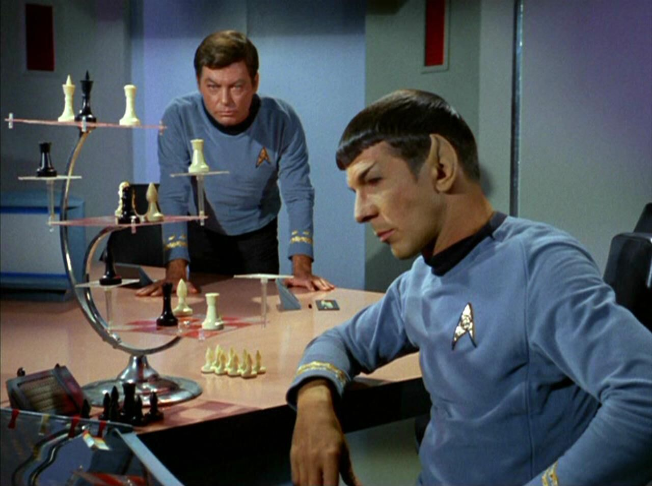
Architectural Evaluation
Evaluating 1st, 2nd and 3rd party risk
Requires in depth understanding of both industries

Slide 20
Organic Attack Surface

Slide 21
2nd Party Attack Surface
Hosted Payloads scenario
Satellite Operator(s)
Payload Operator(s)

Slide 22
3rd Party Attack Surface
Beyond SV resident code execution, an ability to impact a space system stretches far beyond the control of owners and operators
Widely varied, targetable environmental testing facilities
Vacuum chambers
Anechoic chambers
Vibration tables, etc.
Storage and transport for tests and launch
Intra-vehicle tenants & operators

Slide 23
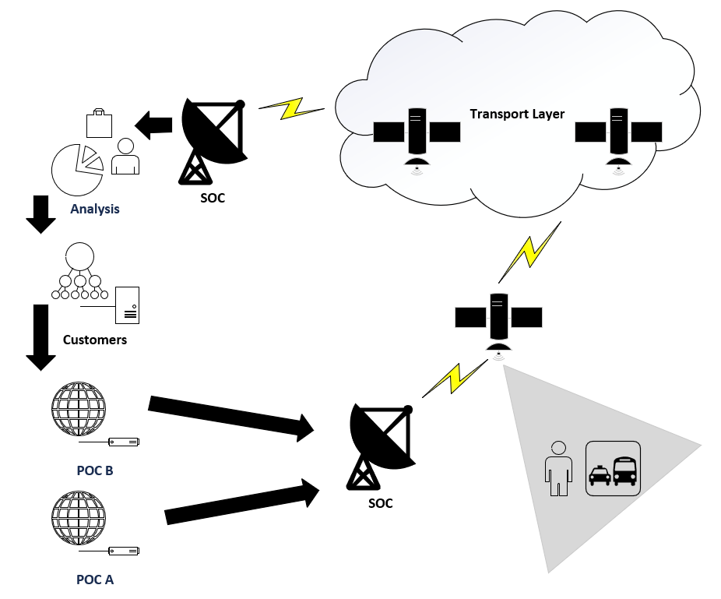
Architecture

Slide 24
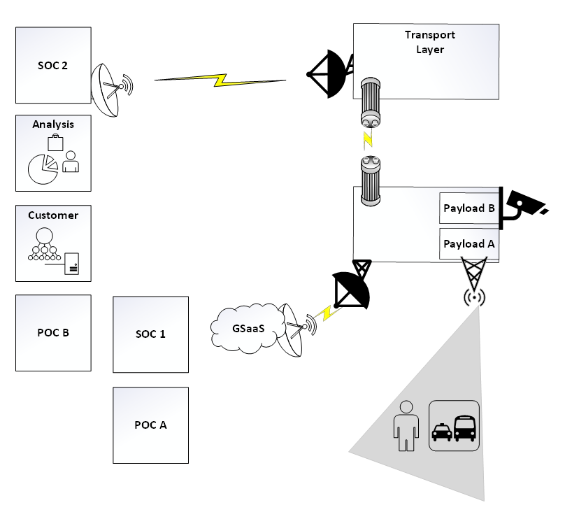

Slide 25
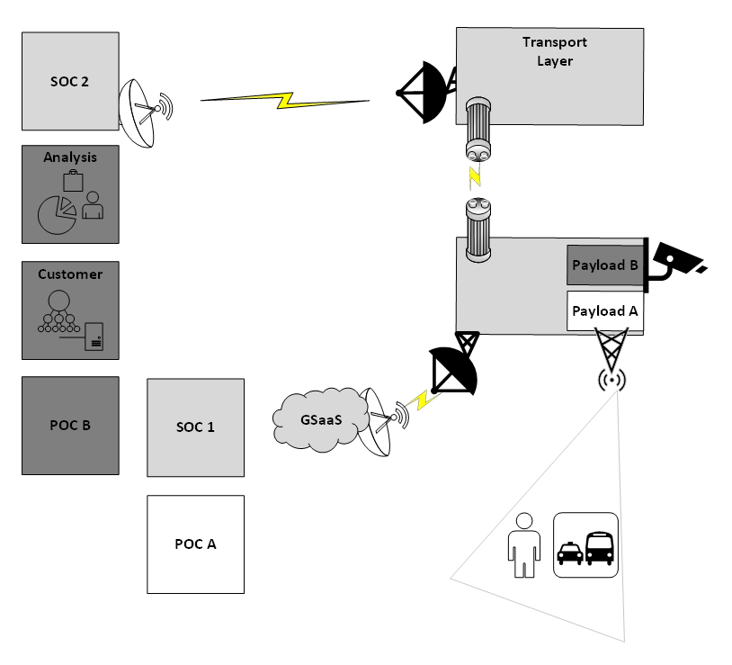

Slide 26
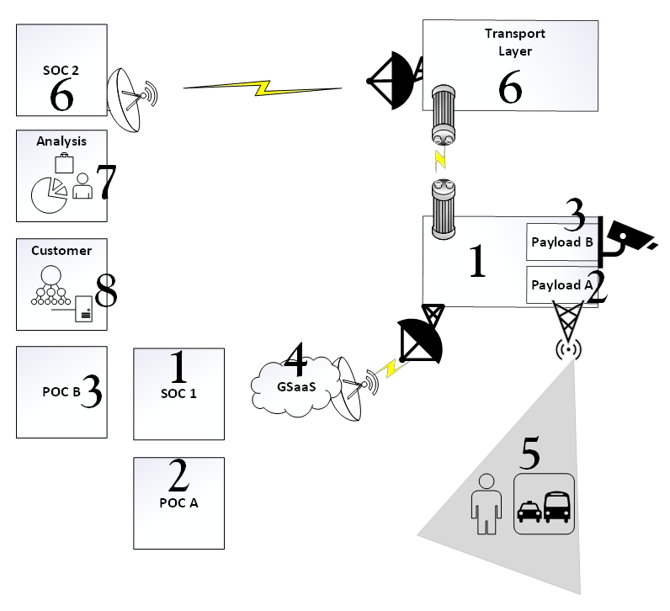
SOC 1 and the satellite Bus are owned by a company offering payload hosting.
POC A and Payload A are owned by a broadcast radio company
POC B and Payload B are owned by a imaging company that takes sensitive images as a service
GSaaS provided by a 3rd party commercial organization.
Users of satellite radio are another customer.
The transport layer SOC 2 and its satellites are owned by a different commercial organization.
Analysis of the images is a different organization.

Slide 27
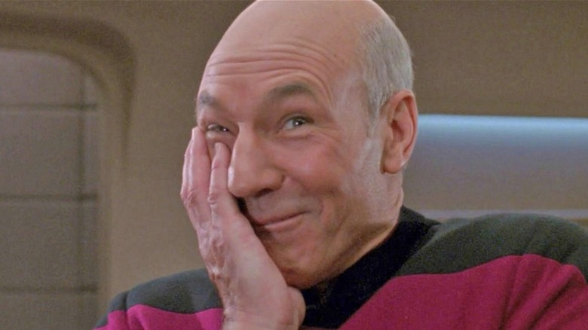
Summary: Space Cyber Convergence Misconceptions
Partial Constellation compromise
Data integrity as a focus of on orbit security
Why bother encrypting optical/laser crosslinks
Cyber Vs EW in space
Space cyber will develop like SCADA cyber
Airgap is safe!
Tempest is a thing!

